Slide 1

Project Title - Seasonal Agriculture Performance Analysis
Student Name – More Maurvika Kisan
College Name – R. C. Patel College of Engineering and Polytechnic, Shirpur
AICTE STU ID : STU6a250dc03bfd81780813248

Slide 2

PROBLEM STATEMENT
Agricultural activities are influenced by seasonal variations in environmental conditions, farming practices, resource availability and market conditions. As a result, agricultural performance may differ from one season to another. However, raw agricultural data does not clearly explain how agricultural performance changes across seasons or what patterns can be observed in different seasonal conditions. The problem is to analyze the given agricultural dataset and investigate seasonal differences in agricultural performance by identifying meaningful patterns, trends, relationships and variations within the available data.

Slide 3
Project Description
Seasonal Agriculture Performance Analysis analyzes agricultural data to understand how farming performance changes across different seasons. Using Python, the project cleans and explores the dataset, compares seasonal patterns, and uses graphs and statistical analysis to identify trends, relationships, and variations. The goal is to transform raw agricultural data into meaningful insights that can help understand seasonal farming performance.

Slide 4

WHO ARE THE END USERS?
The main end users of this project are the people who need to understand agricultural performance and make better decisions based on seasonal data:
Farmers – to understand which seasons and conditions are more favorable for different crops.
Agricultural officers and departments – to study seasonal agricultural trends and plan support or schemes.
Agricultural researchers and students – to analyze patterns and relationships in agricultural data.
Agribusiness and market planners – to understand production trends that may affect planning and supply.
Policy makers – to use data-based insights while making agricultural policies and resource-allocation decisions.
The project is useful for anyone who wants to turn agricultural data into easy-to-understand seasonal insights for better planning and decision-making.

Slide 5

Technology Used
Python – Main programming language for the project.
Pandas – Used to clean, organize, filter, and analyze the agricultural data.
NumPy – Used for numerical calculations and data operations.
Matplotlib – Used to create graphs and visualize seasonal patterns and trends.
Jupyter Notebook – Used as the working environment to write and run the analysis step by step.

Slide 6
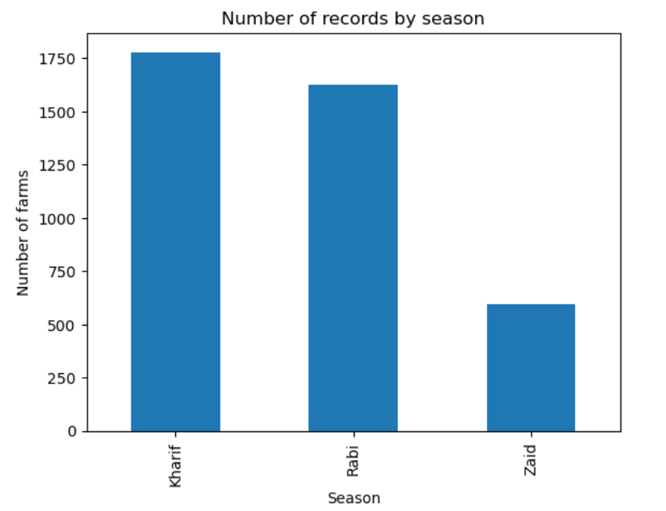
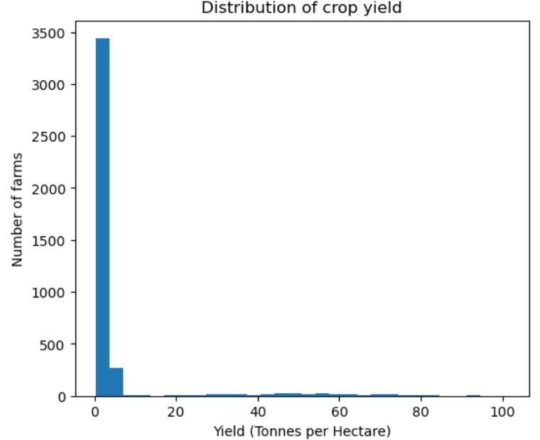
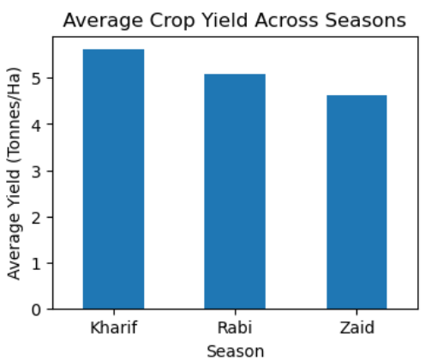
RESULTS
Kharif has the highest number of records with 1,779 farms, followed by Rabi with 1,627 farms and Zaid with 594 farms. Therefore, the dataset has much more representation from Kharif and Rabi than Zaid.
The yield distribution is right-skewed. Most farms have relatively low yield values, while a smaller number of farms have very high yields. The overall median yield is around 1.74 tonnes/ha, whereas the maximum reaches 101.44 tonnes/ha. This large difference is mainly influenced by high-yield crops such as Sugarcane.
Kharif has the highest average yield, while Zaid has the lowest. The difference between Kharif and Zaid is about 0.99 tonnes/ha, or approximately 21.34% relative to Zaid's average.

Slide 7
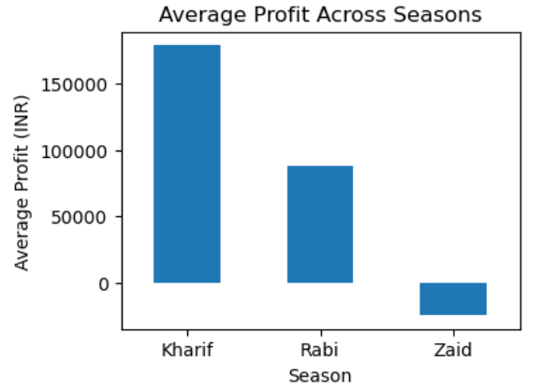
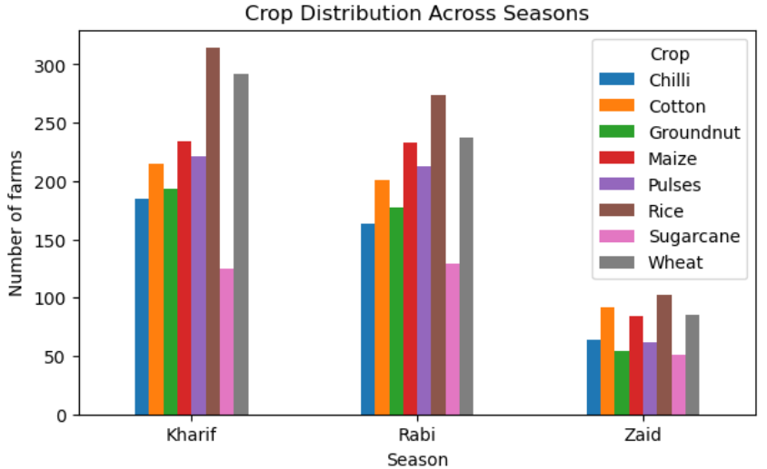
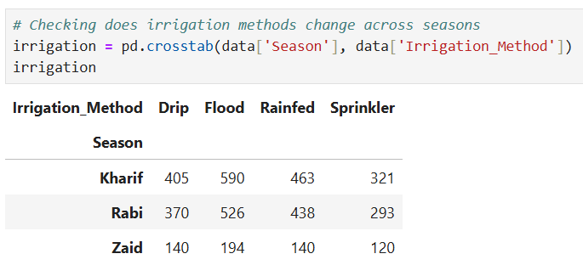
RESULTS
Kharif is the most profitable season on average, while Zaid shows a negative average profit. Rabi remains profitable but at a much lower level than Khari
Rice is the most frequently represented crop in all three seasons. Kharif has the highest number of records for almost every crop, while Zaid has substantially fewer records.

Slide 8
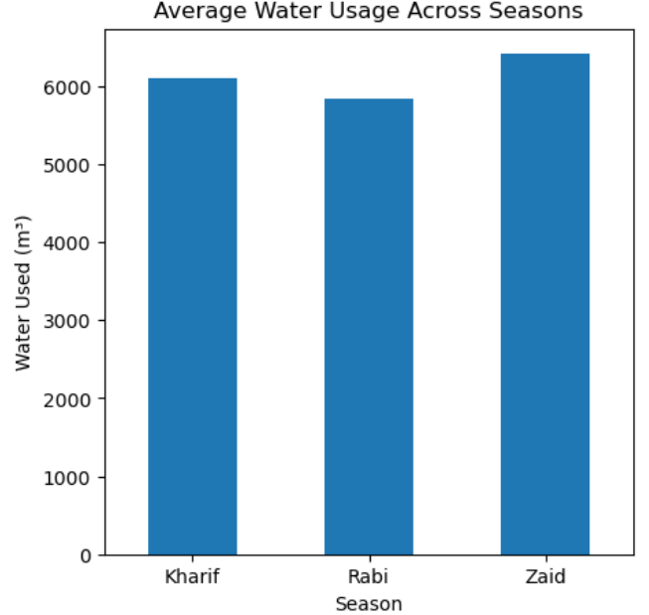
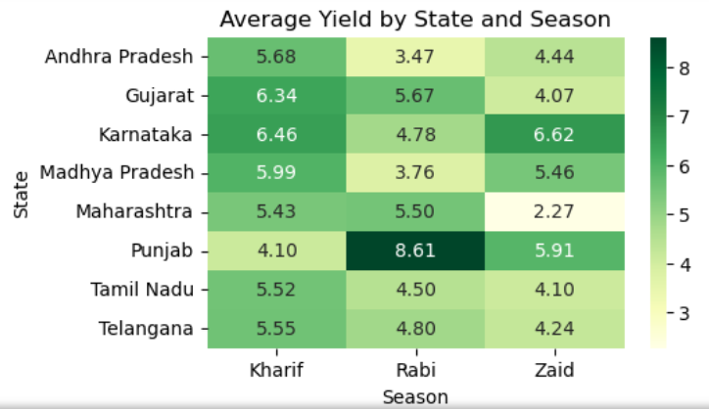
RESULTS
Zaid has the highest average water consumption, even though it has the lowest average yield. Rabi has the lowest average water usage among the three seasons.
Punjab performs exceptionally well in Rabi: 8.61 tonnes/ha.
Karnataka performs best in Zaid: 6.62 tonnes/ha.
Gujarat performs best in Kharif: 6.34 tonnes/ha.
Maharashtra has particularly low Zaid yield: 2.27 tonnes/ha.

Slide 9
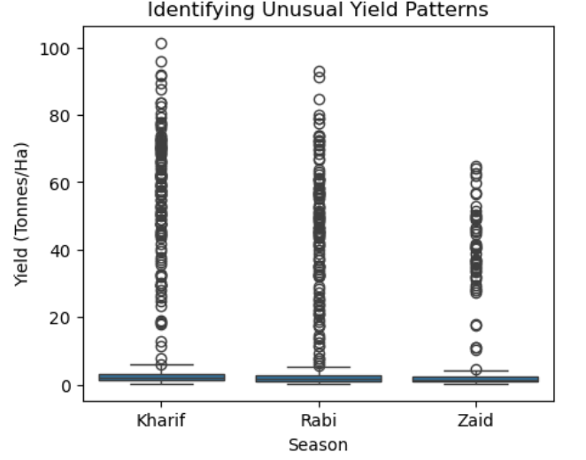
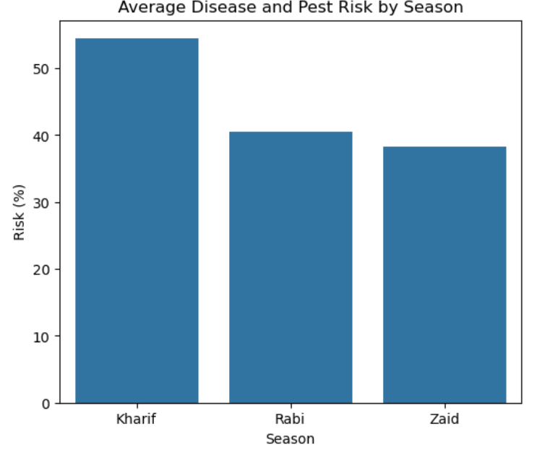
RESULTS
The box plot shows that yield varies substantially within each season. Kharif has the highest median yield (1.95 tonnes/ha), followed by Rabi (1.66) and Zaid (1.45). There are also several high-yield observations, especially from Sugarcane, which create visible outliers. The notebook identifies the highest-yield record as 101.44 tonnes/ha for Sugarcane in Kharif.
Kharif has the highest average disease/pest risk, followed by Rabi and Zaid. Therefore, Kharif's higher agricultural performance comes along with a higher recorded risk level in this dataset.

Slide 10
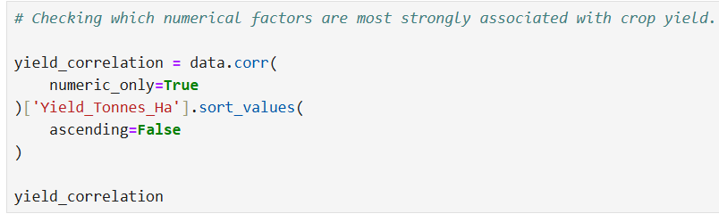
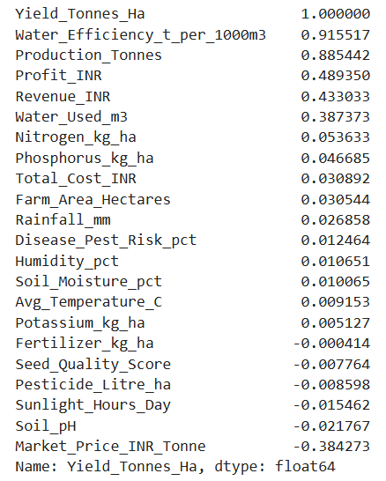
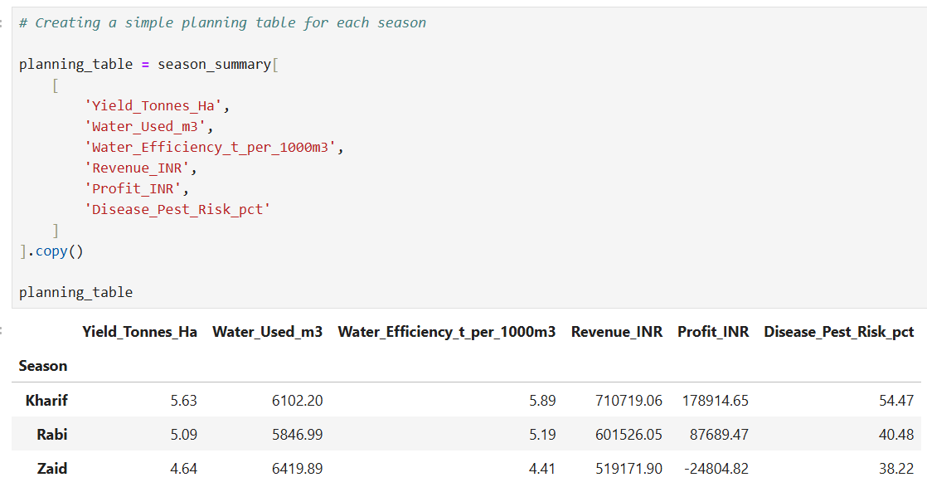
RESULTS

Slide 11
Future scope
In the future, this project can be expanded from basic seasonal analysis into a more useful agricultural decision-support system.
Real-time data: Add live weather, rainfall, soil, and market-price data for more practical analysis.
Crop prediction: Use machine learning to predict crop yield based on seasonal and environmental conditions.
Season recommendation: Suggest suitable crops or farming periods based on past performance and current conditions.
Regional analysis: Compare agricultural performance across different districts, states, or regions.
Interactive dashboard: Build a Power BI or web dashboard so farmers and agricultural officers can explore the results easily.
Early warnings: Identify unusual seasonal patterns that may indicate risks such as low yield or unfavorable conditions.

Slide 12
GitHub Link
https://github.com/AswiniKumar55/-Seasonal-Agriculture-Performance-Analysis-.git

Slide 13

VOIS Course completion certificate -
Course name- Data Visualization

Slide 14
Thank you
.
.

